Slide 1
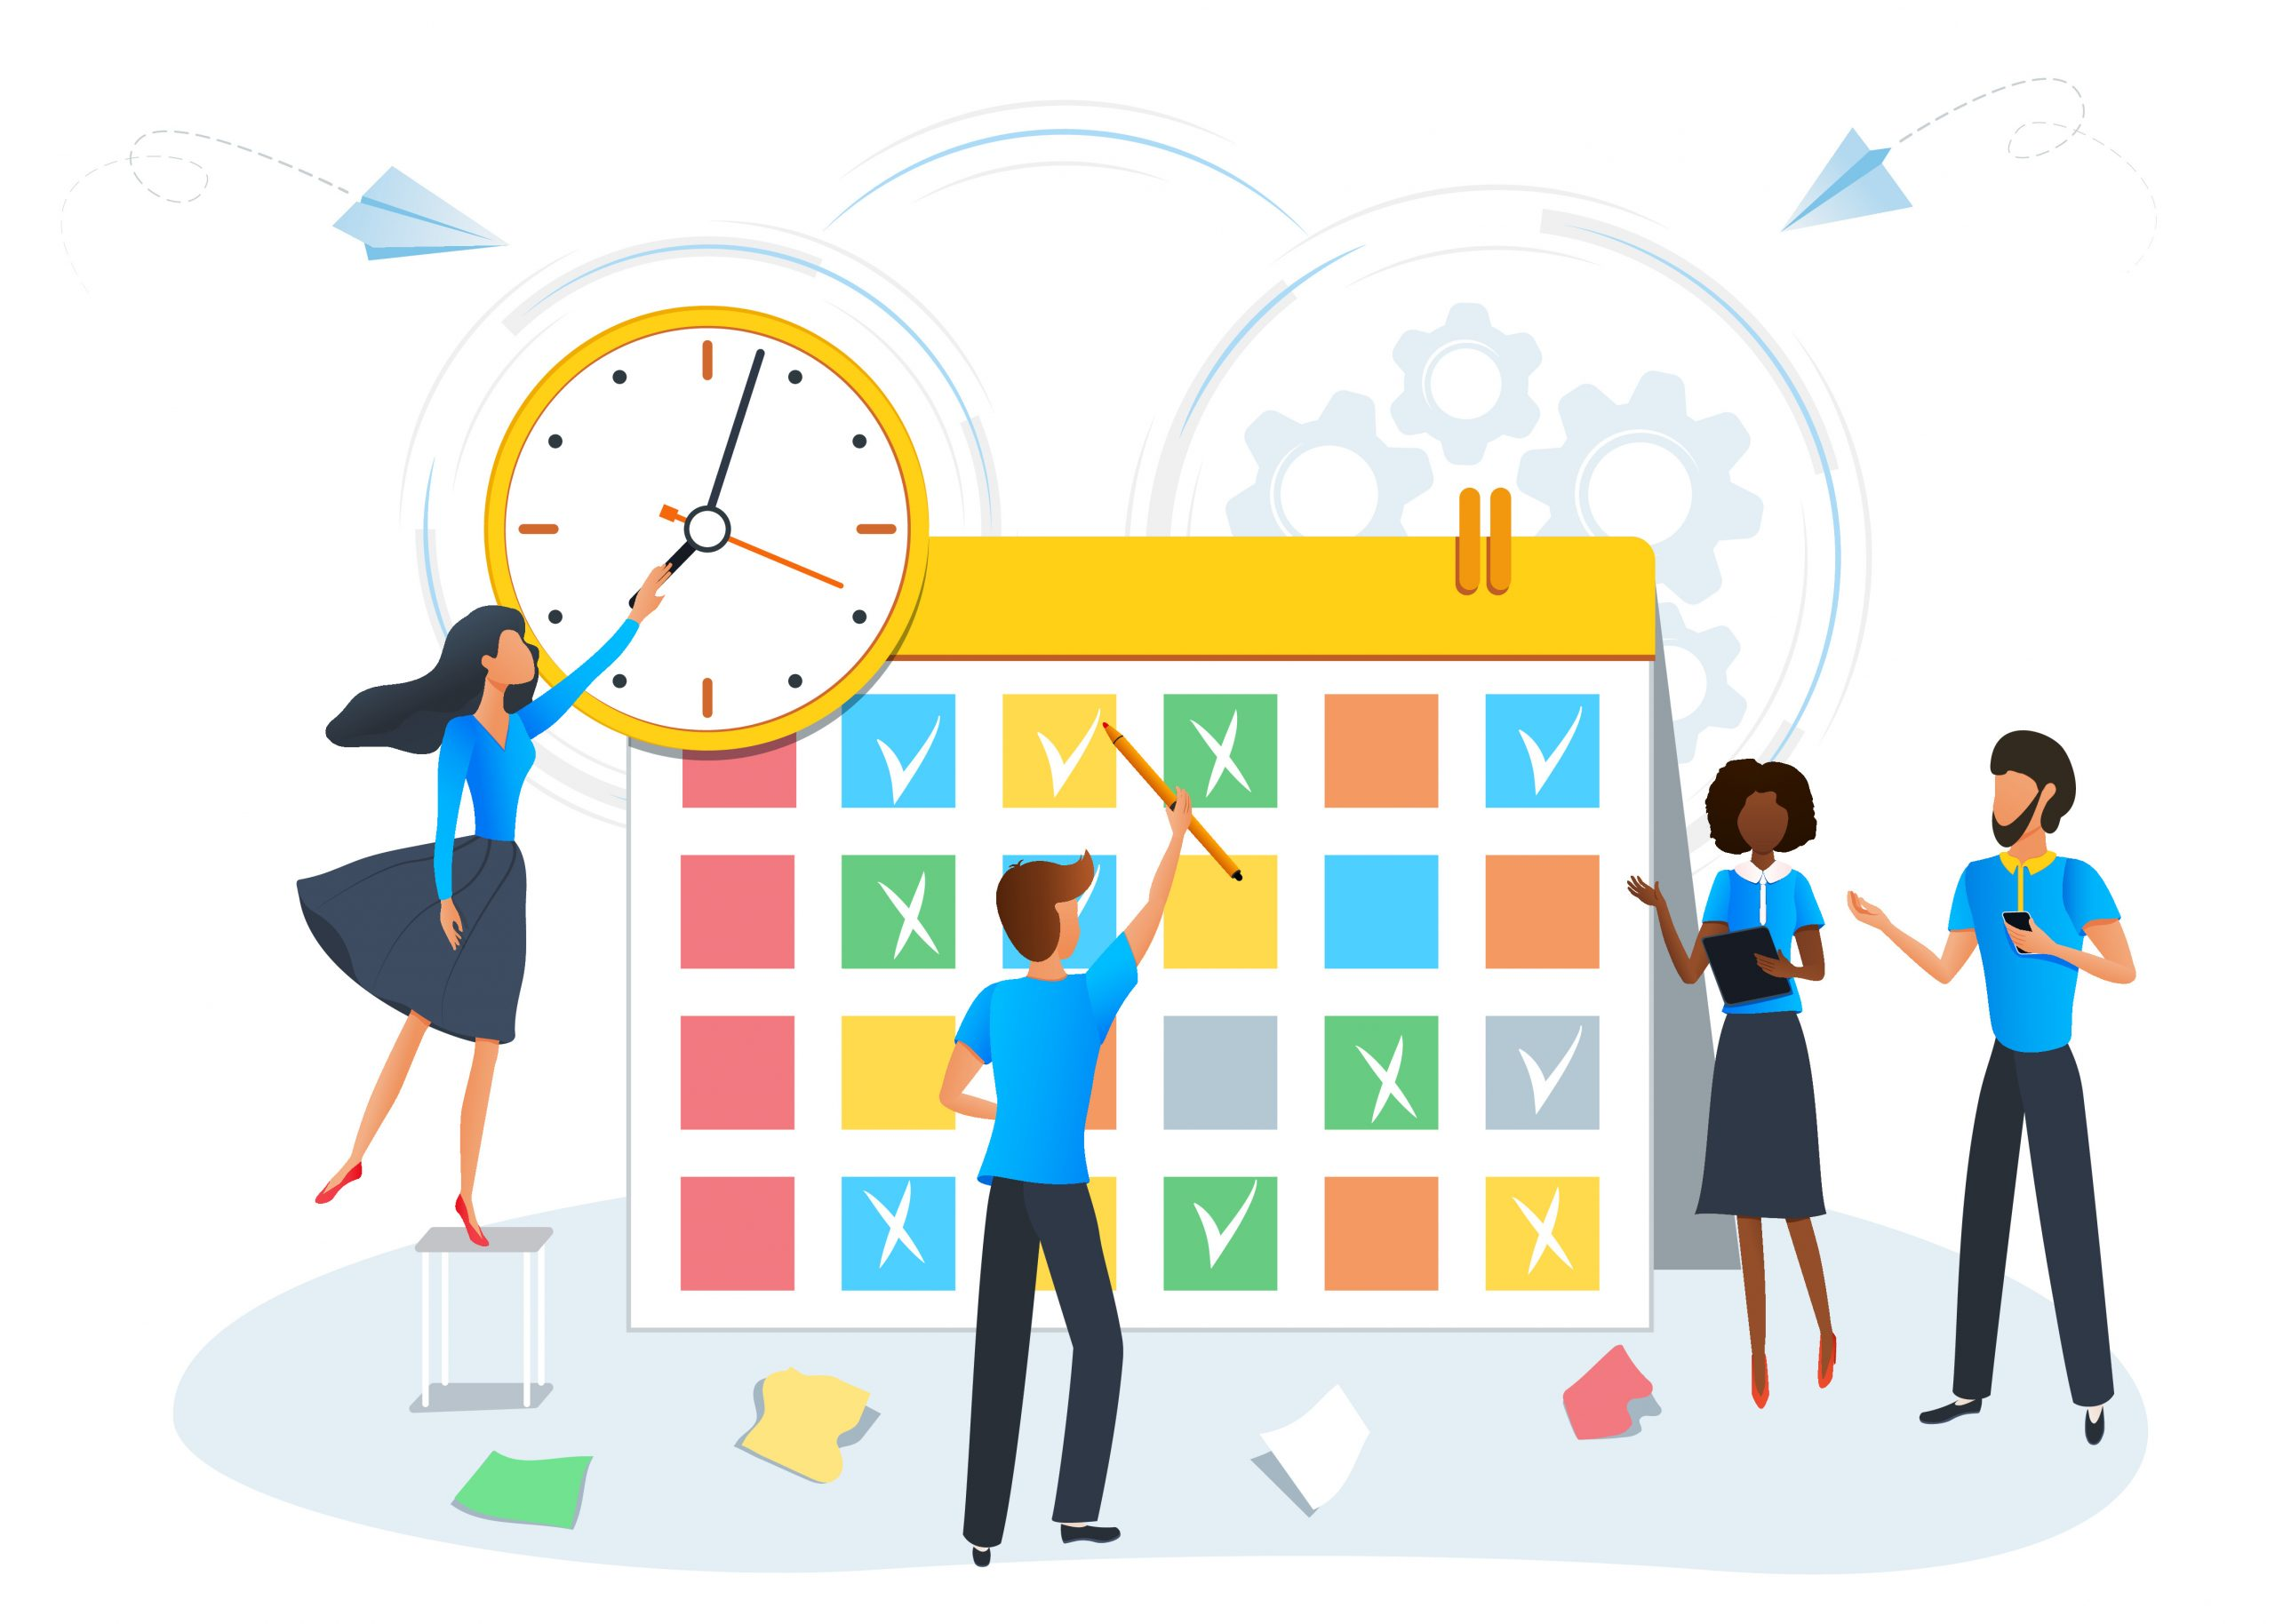
Ticket System Extension of DVerse (Collaborating Bots)
Description
A ticket system that has basic information about a certain events like festivals, it will feature stuff like: showing information about a festival, booking a festival etc.
By Reno and Brett

Slide 2
Challenges
Non-Functional Requirements
Developing a platform that shows festival information
Handle large number of users at the same time (when booking a ticket)
Make a secure platform, especially when handling user data
Making payments to book a ticket
Security
Scalability
Availability

Slide 3
Ideas
Link to group project
Securing user data
‘Big’ user data
Multiple environments
CI/CD pipelines
Host on the cloud
Login System
Different Agents
Bots and services
Activity Pub Protocol

